Slide 1


Web Development with .NET Lecture 7: LINQ 15 March 2010
MET CS 651
“Data Binding, Next Generation”

Slide 2

Templates
ASP.NET AJAX

Slide 3
Using client-side Templates instead of server-side
Demo
Class Exercise

Slide 4

Lambda Expressions
An Introduction to

Slide 5
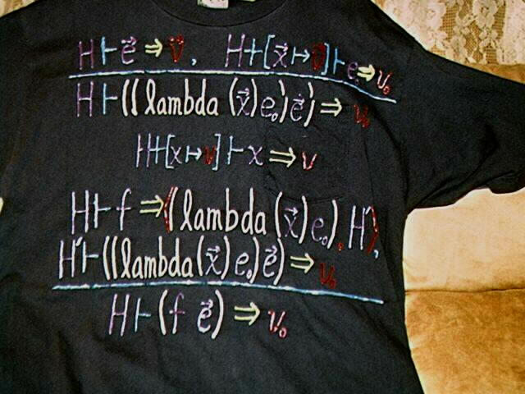
U’re not a computer wonk unless…

Slide 6
.NET 1.0
Let’s go back to the time of .NET 1.0 (C# 1.0) and start with the concepts of delegates.
Delegates are a concept that wasn’t completely new with the advent of .NET. It was there before and for example in C++ they were called “function pointer”, which is probably more clear about what they do: a delegate holds a reference to a function (or method; whatever you like more) and allows you to call that function later on in time
In .NET they renamed the concept to “delegate” and added type-safety to it.
That means you have to exactly specify in the delegate what result type you expect and how many arguments and of what type you expect.
After that you can use your delegate to point it to a method that has the specified signature; if you try to point it to a method with another signature you will get a compiler error, which is good! You can then pass the method around as if it is a variable:

Slide 7
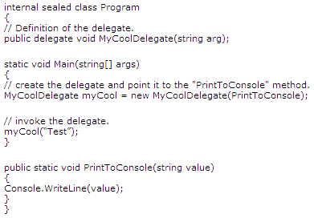
Delegate Example

Slide 8
.NET 2.0
A delegate is just a reference to a method that you can use as if it is a variable.
You can pass it to methods and invoke it whenever you think it is required.
Delegates are a powerful concept because now not only variables are data, but also functions/methods can be treated as if they are data. Functions have become first class citiziens
Let’s fast forward a little bit and stop at the time when .NET 2.0 and C# 2.0 were released.
For C# 2.0, the C# team added something very nice and useful: anonymous delegates or better known as anonymous methods.
The difference between anonymous methods and traditional delegates (as in .NET 1.0) is only that you don’t need to define a method somewhere else and point to it with a delegate to do the job.
You directly define the method where you would create the delegate and the C# compiler will take care of it. The C# compiler will create the method for you and convert it into something that looks exactly like in .NET 1.0

Slide 9
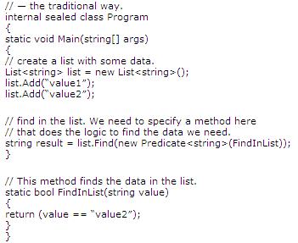
The Traditional Way

Slide 10
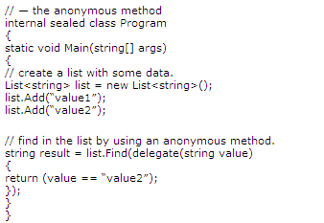
The Anonymous Method

Slide 11
Anonymous Methods are our friends!
With the anonymous method we don’t need to create another method and a delegate that points to that method
We just say that we want to use a delegate here and specify the body of the method.
It’s much more convenient to use an anonymous method instead of the traditional delegate way. The reason for that is that the code that belongs together stays together

Slide 12
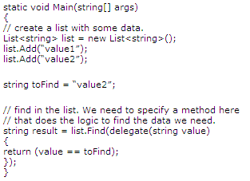
Outside Scope Variables
Another nice feature that has been introduced with anonymous methods is the possibility to use variables that are defined outside of the method inside the method
Magic that is done by the C# compiler: The C# compiler doesn’t only create a method for us but a whole class (that contains the method) where the value that we use in the body is passed in as class member.
That is why we can access the value inside of the method body: as class member it is part of the class and you have access to the class members from inside a method

Slide 13
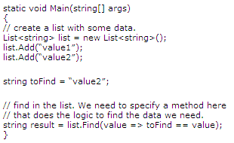
.NET 3.5
Lambda expressions are just the next step in the “delegate evolution”. The compiler now even hides away the whole “delegate(…) { … }”. It’s is very convenient because that saves us a lot of typing!
A lambda expression always consists of a left and a right part.
The left part holds the list of arguments, where we even don’t need to specify the types because they can be automatically fetched by the compiler
The right side contains the body of the method. A lambda expression always expects us to return some value that is why we can also omit the “return” keyword

Slide 14
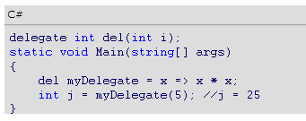
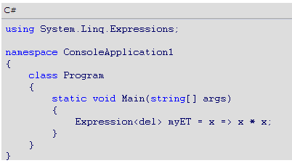
Lambda Expressions
A lambda expression is an anonymous function that can contain expressions and statements, and can be used to create delegates or expression tree types
All lambda expressions use the lambda operator =>, which is read as "goes to“
The left side of the lambda operator specifies the input parameters (if any) and the right side holds the expression or statement block
The lambda expression x => x * x is read "x goes to x times x"

Slide 15




Expression Lambdas
A lambda expression with an expression on the right side is called an expression lambda
Expression lambdas are used extensively in the construction of Expression Trees
An expression lambda returns the result of the expression and takes the following basic form:

Slide 16


Statement Lambdas
A statement lambda resembles an expression lambda except that the statement(s) is enclosed in braces
The body of a statement lambda can consist of any number of statements; however, in practice there are typically no more than two or three
Statement lambdas, like anonymous methods, cannot be used to create expression trees

Slide 17
Variable Scope in Lambda Expressions
Lambdas can refer to outer variables that are in scope in the enclosing method or type in which the lambda is defined
Variables that are captured in this manner are stored for use in the lambda expression even if variables would otherwise go out of scope and be garbage collected.
An outer variable must be definitely assigned before it can be consumed in a lambda expression
The following rules apply to variable scope:
A variable that is captured will not be garbage-collected until the delegate that references it goes out of scope
Variables introduced within a lambda expression are not visible in the outer method
A lambda expression cannot directly capture a ref or out parameter from an enclosing method
A return statement in a lambda expression does not cause the enclosing method to return
A lambda expression cannot contain a goto statement, break statement, or continue statement whose target is outside the body or in the body of a contained anonymous function

Slide 18
Lambda Demo
Console1, Website2

Slide 19
LINQ
A (serious) Introduction to

Slide 20


C# 3.0 Design Goals
Integrate objects, relational data, and XML
And
Increase conciseness of language
Add functional programming constructs
Don’t tie language to specific APIs
Remain 100% backwards compatible

Slide 21
from c in Customers
where c.City == "Hove"
select new { c.Name, c.Address };

Slide 22
The Syntax
Starts with from
Zero or more from, join, let, where, or orderby
from id in source
{ from id in source |
join id in source on expr equals expr [ into id ] |
let id = expr |
where condition |
orderby ordering, ordering, … }
select expr | group expr by key
[ into id query ]
Ends with
select or group by
Optional into continuation

Slide 23




Language INtegrated Query (LINQ)
VB
C#
Others…
.NET Language-Integrated Query
LINQ enabled data sources
LINQ enabled ADO.NET
LINQ
To Objects
LINQ
To DataSets
LINQ
To SQL
LINQ
To Entities
LINQ
To XML
<book>
<title/>
<author/>
<price/>
</book>
Objects
Relational
XML

Slide 24
The rest of this mini-Lesson
Language Enhancements
Local Variable Type Inference
Object Initializers
Anonymous Types
Lambda Expressions
Extension Methods
+ Query Expressions
= LINQ ☺

Slide 25
Local Variable Type Inference
int i = 666;
string s = "Goodbye";
double d = 3.14;
int[] numbers = new int[] {1, 2, 3};
Dictionary<int,Order> orders = new Dictionary<int,Order>();
var i = 666;
var s = "Goodbye";
var d = 3.14;
var numbers = new int[] {1, 2, 3};
var orders = new Dictionary<int,Order>();
“The type on the right hand side”

Slide 26
Object Initializers
public class Point
{
private int x, y;
public int X { get { return x; } set { x = value; } }
public int Y { get { return y; } set { y = value; } }
}
Field or property assignments
Point a = new Point { X = 0, Y = 1 };
Point a = new Point();
a.X = 0;
a.Y = 1;

Slide 27
Anonymous Types
class XXX
{
public string Name;
public int Age;
}
XXX
var o = new { Name = “Jenny”, Age = 31 };

Slide 28
Implementing Delegates
public class MyClass
{
public static void Main() {
List<Customer> customers = GetCustomerList();
List<Customer> locals =
customers.FindAll(
new Predicate<Customer>(CityEqualsHove)
);
}
static bool CityEqualsHove(Customer c) {
return c.City == "Hove";
}
}

Slide 29
Anonymous Delegates: Good
public class MyClass
{
public static void Main() {
List<Customer> customers = GetCustomerList();
List<Customer> locals =
customers.FindAll(
delegate(Customer c) { return c.City == "Hove"; }
);
}
}

Slide 30
Lambda Expressions: Better!
public class MyClass
{
public static void Main() {
List<Customer> customers = GetCustomerList();
List<Customer> locals =
customers.FindAll(
(Customer c) => {return c.City == "Hove";}
);
}
}
Lambda expression

Slide 31
Lambda Expressions: Type inferred!
public class MyClass
{
public static void Main() {
List<Customer> customers = GetCustomerList();
List<Customer> locals =
customers.FindAll(
c => c.City == "Hove"
);
}
}
Lambda expression

Slide 32
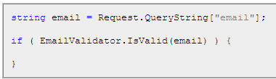
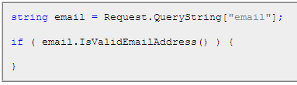
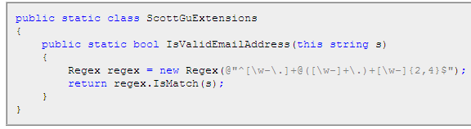
Extension Methods

Slide 33
Extension Methods
Note how the static method had a "this" keyword before the first parameter argument of type string.
This tells the compiler that this particular Extension Method should be added to objects of type "string".
Within the IsValidEmailAddress() method implementation I can then access all of the public properties/methods/events of the actual string instance that the method is being called on, and return true/false depending on whether it is a valid email or not.
To add this specific Extension Method implementation to string instances within my code, I simply use a standard "using" statement to import the namespace containing the extension method implementation:
using ScottGuExtensions;

Slide 34
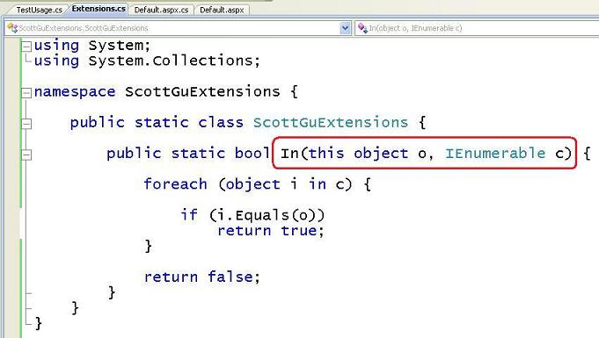
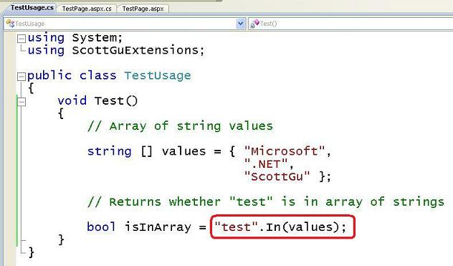
Another Example

Slide 35
Extension Methods
Extension method
namespace MyStuff
{
public static class Extensions
{
public static string Concatenate(this IEnumerable<string> strings,
string separator) {…}
}
}
Brings extensions into scope
using MyStuff;
string[] names = new string[] { "Jenny", "Daniel", "Rita" };
string s = names.Concatenate(", ");
obj.Foo(x, y)
↓
XXX.Foo(obj, x, y)
IntelliSense!

Slide 36
Bringing it all together and introducing the System.Linq namespace
Notes:
// execute query
var results =
Person.GetPeople()
.Where(p => p.IsMarried)
.Select(p => new { Name = p.Name, Age = p.Age });
--
using System;
using System.Collections.Generic;
namespace MyLinq
{
public delegate TRes Func<TSrc, TRes>(TSrc src);
public static class Enumerable
{
public static IEnumerable<TSrc> Where<TSrc>(this
IEnumerable<TSrc> source, Func<TSrc, bool> predicate)
{
List<TSrc> res = new List<TSrc>();
foreach (TSrc s in source)
{
if (predicate(s))
{
res.Add(s);
}
}
return res;
}
public static IEnumerable<TRes> Select<TSrc, TRes>(this
IEnumerable<TSrc> source, Func<TSrc, TRes> selector)
{
List<TRes> res = new List<TRes>();
foreach (TSrc s in source)
{
res.Add(selector(s));
}
return res;
}
}
}

Slide 37
Query Expressions
Queries translate to method invocations
Where, Join, OrderBy, Select, GroupBy, …
from c in customers
where c.City == "Hove"
select new { c.Name, c.Phone };
customers
.Where(c => c.City == "Hove")
.Select(c => new { c.Name, c.Phone });

Slide 38
Query Expressions
Starts with from
Zero or more from, join, let, where, or orderby
from id in source
{ from id in source |
join id in source on expr equals expr [ into id ] |
let id = expr |
where condition |
orderby ordering, ordering, … }
select expr | group expr by key
[ into id query ]
Ends with
select or group by
Optional into continuation

Slide 39
Query Expressions
Project | Select <expr>
Filter | Where <expr>, Distinct
Test | Any(<expr>), All(<expr>)
Join | <expr> Join <expr> On <expr> Equals <expr>
Group | Group By <expr>, <expr> Into <expr>, <expr> Group Join <decl> On <expr> Equals <expr> Into <expr>
Aggregate | Count(<expr>), Sum(<expr>), Min(<expr>), Max(<expr>), Avg(<expr>)
Partition | Skip [ While ] <expr>, Take [ While ] <expr>
Set | Union, Intersect, Except
Order | Order By <expr>, <expr> [ Ascending | Descending ]
Notes:
Group Join is essentially “Left outer join” for hierarchical data

Slide 40
More Examples of LINQ queries
Notes:
processes and process collection

Slide 41
C# 3.0 Language Innovations
Query expressions
var contacts =
from c in customers
where c.City == "Hove"
select new { c.Name, c.Phone };
Local variable type inference
Lambda expressions
var contacts =
customers
.Where(c => c.City == "Hove")
.Select(c => new { c.Name, c.Phone });
Extension methods
Anonymous types
Object initializers

Slide 42
before the summary, One last feature...

Slide 43
Expression Trees
public delegate bool Predicate<T>(T item);
Expression<Predicate<Customer>> test = c => c.City == "Hove";
ParameterExpression c =
Expression.Parameter(typeof(Customer), "c");
Expression expr =
Expression.Equal(
Expression.Property(c, typeof(Customer).GetProperty("City")),
Expression.Constant("Hove")
);
Expression<Predicate<Customer>> test =
Expression.Lambda<Predicate<Customer>>(expr, c);

Slide 44
Expression Trees
public delegate bool Predicate<T>(T item);
Predicate<Customer> test = c => c.City == "Hove";
Predicate<Customer> test = new Predicate<Customer>(XXX);
private static bool XXX(Customer c) {
return c.City == "Hove";
}

Slide 45
Expression Trees
Expression trees represent language-level code in the form of data
The data is stored in a tree-shaped structure
Each node in the expression tree represents an expression, for example a method call or a binary operation such as x < y

Slide 46
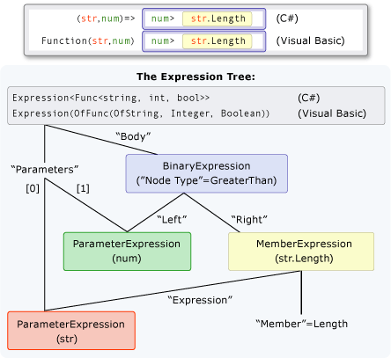
Expression Tree Example

Slide 47
Expression Trees and Lambdas
When a lambda expression is assigned to a variable of type Expression<(Of <(TDelegate>)>), the compiler emits an expression tree that represents the lambda expression.
For example, some standard query operator methods that are defined in the Queryable class have parameters of type Expression<(Of <(TDelegate>)>). When you call these methods, you can pass in a lambda expression and the compiler will generate an expression tree
The Expression<(Of <(TDelegate>)>) type provides the Compile method, that compiles the code represented by the expression tree into an executable delegate
This executable code is equivalent to the executable code that would have been generated had the lambda expression been assigned to a delegate type originally
Only those expression trees that represent functions, namely Expression<(Of <(TDelegate>)>) and its parent type LambdaExpression, can be compiled into executable code. To execute other types of expression trees, you must first wrap them in a LambdaExpression node. You can obtain such a LambdaExpression by calling the Lambda method and passing the expression tree as the argument

Slide 48
LINQ Architecture
var query = from c in customers where c.City == "Hove" select c.Name;
var query = customers.Where(c => c.City == "Hove").Select(c => c.Name);
Source implements IEnumerable<T>
Source implements IQueryable<T>
System.Linq.Enumerable Delegate based
System.Linq.Queryable Expression tree based
Objects
SQL
DataSets
Others…

Slide 49
demos
LINQ Extension Methods

Slide 50
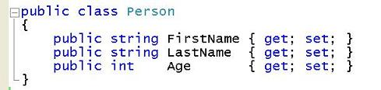
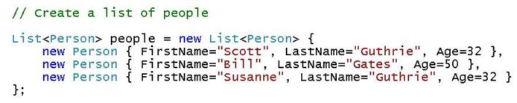
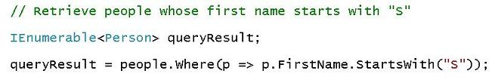
Using LINQ Extension Methods Against In-Memory .NET Objects
Assume we have defined a class to represent a "Person“:
Use the new object Initializer and collection Initializer features to create and populate a collection of "people“
Use the standard "Where()" extension method provided by System.Linq to retrieve a sequence of those "Person" objects within this collection whose FirstName starts with the letter "S"

Slide 51
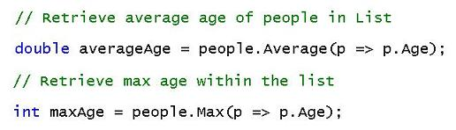
Additional Manipulations

Slide 52
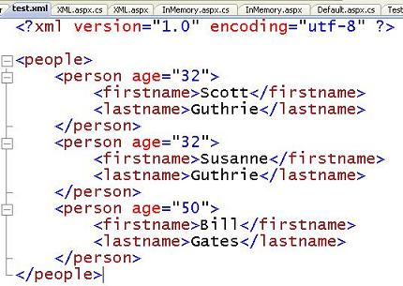
Using LINQ Extension Methods Against an XML File
Let's assume we have an XML file on disk that contains the data below
I could use the existing System.Xml APIs today to either load this XML file into a DOM and access it, or use a low-level XmlReader API to manually parse it myself
I can now use the System.Xml.Linq implementation that supports the standard LINQ extension methods (aka "XLINQ") to more elegantly parse and process the XML

Slide 53
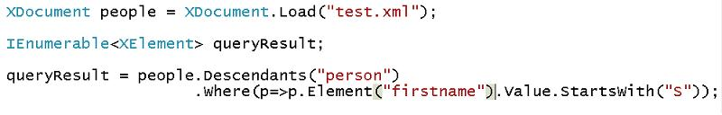
Using LINQ Extension Methods Against an XML File
The below code-sample shows how to use LINQ to retrieve all of the <person> XML Elements that have a <person> sub-node whose inner value starts with the letter "S":
The code above uses the exact same Where() extension method as with the in-memory object sample.
Right now it is returning a sequence of "XElement" elements, which is an un-typed XML node element.

Slide 54
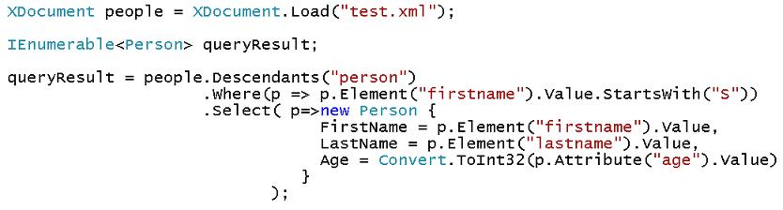
Using LINQ Extension Methods Against an XML File
A Lambda expression that uses the new object initializer syntax to populate the same "Person" class that we used with our first in-memory collection example
The above code does all the work necessary to open, parse and filter the XML in the "test.xml" file, and return back a strongly-typed sequence of Person objects
I could also use the same Average() and Max() LINQ extension methods as before to calculate the average age of <person> elements within the XML file, as well as the maximum age

Slide 55
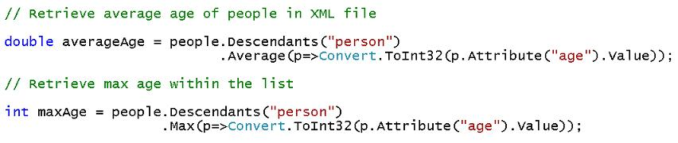
Using LINQ Extension Methods Against an XML File
Using the same Average() and Max() LINQ extension methods as before to calculate the average age of <person> elements within the XML file, as well as the maximum age
I do not have to manually parse the XML file.
Not only will XLINQ handle that for me, but it will parse the file using a low-level XMLReader and not have to create a DOM in order to evaluate the LINQ expression
This means that it is lightening fast and doesn't allocate much memory

Slide 56
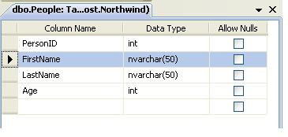
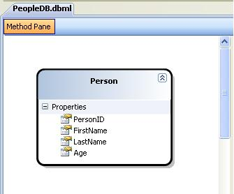
Using LINQ Extension Methods Against a Database
Let's assume we have a SQL database that contains a table called "People" that has the following database schema
Use the new LINQ to SQL WYSIWYG ORM designer within Visual Studio to quickly create a "Person" class that maps to the database

Slide 57
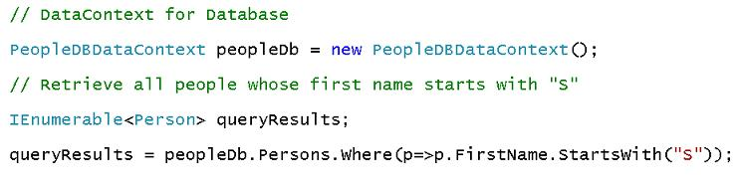
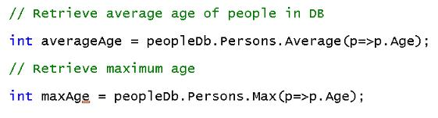
Using LINQ Extension Methods Against a Database
I can then use the same LINQ Where() extension method I used previously with objects and XML to retrieve a sequence of strongly-typed "Person" objects from the database whose first name starts with the letter "S":
I could then use the same LINQ Average() and Max() extension methods as before to retrieve the average and maximum age values from the database like so:

Slide 58
Declarative code improves code comprehension!
When used correctly, Extension Methods can significantly improve code comprehension within code reviews, and lead to fewer lines of code and fewer bugs
They allow you to more clearly express your intent. For example, instead of a filter like below with imperative code:
List<Person> originalList = ...;
List<Person> results = new List<Person>;
foreach(Person p in originalList) {
if (p.Age > 50) {
results.Add(p);
}
}
You could instead just write:
results = originalList.Where(p=>p.Age > 50).ToList();

Slide 59
Homework
Sort text by words. Use declarative LINQ (and lambda expressions) to sort input text into 10 different listboxes, where each listbox represents the number of letters in each word
So listbox1 is for 1-letter words, listbox2 is for 2-letter words, etc.., and listbox10 is for words of 10 letters or more (including supercalifragilisticespelidocious..)
Each listbox is alphabetically sorted
Use your favorite CSS and make the web page look good
Next week, midterm

Slide 60


